Slide 1
PYTHON PROGRAMMING
Project 4 — The General Knowledge Quiz
Technical Documentation & Project Report
Author: Laiba Maqbool
Batch: DecodeLabs Industrial Training 2026

Slide 2
OVERVIEW
Project Overview
Goal
Python Concepts Used
Develop a console-based General Knowledge Quiz that asks the player 3 questions, checks each answer, awards one point per correct response, and reports a full performance summary — score, percentage, letter grade, and a personalized remark.
Variables
Lists
Functions
Loops
If-Else Statements
String Methods
Input Validation
Score Tracking
f-Strings
Program Flow
Welcome + Rules
Get Player Name
Countdown
Ask 3 Questions
Score + Grade
Play Again?
Laiba Maqbool · DecodeLabs Industrial Training 2026
2

Slide 3
STRUCTURE
Program Structure
Eight functions, each handling one clear responsibility.
display_welcome()
display_rules()
Prints the welcome banner and quiz introduction.
Explains scoring rules before the quiz begins.
get_player_name()
countdown()
Loops until a non-empty name is entered; title-cases it.
Prints a short 3-2-1 countdown before questions start.
ask_question()
run_quiz()
Asks one question, sanitizes input, checks the answer.
Runs the full quiz: loops questions, tallies score, shows results.
play_again()
main()
Validates Y/N input and asks if the player wants another round.
Entry point — loops run_quiz() until the player chooses to stop.
Laiba Maqbool · DecodeLabs Industrial Training 2026
3

Slide 4
DATA HANDLING
Input Handling & Validation
" MARS "
.strip()
.lower()
in [answers]
Raw Input
→ "MARS"
→ "mars"
Match ✅
Multiple Correct Answers
Name Validation Loop
Play-Again Validation
Q3 accepts a list — ["pacific", "pacific ocean"] — so answers are checked with the 'in' operator instead of a single '=='.
get_player_name() uses while True to keep re-prompting until the player enters a non-empty name.
play_again() rejects anything except 'y' or 'n' and re-asks, preventing invalid program states.
Laiba Maqbool · DecodeLabs Industrial Training 2026
4

Slide 5
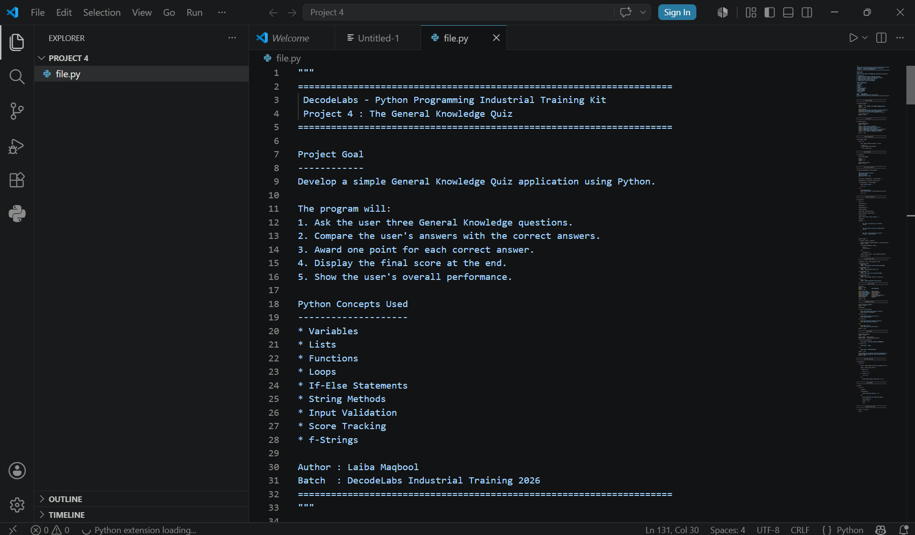

Slide 6
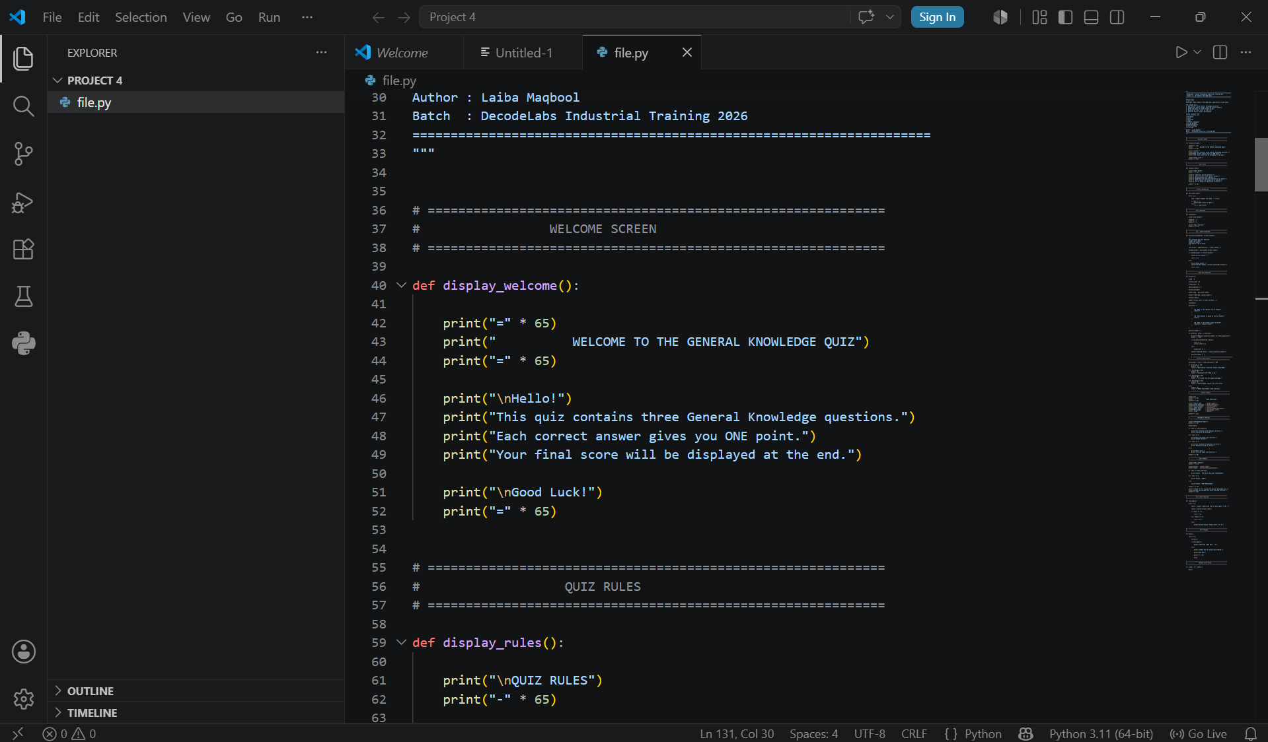

Slide 7
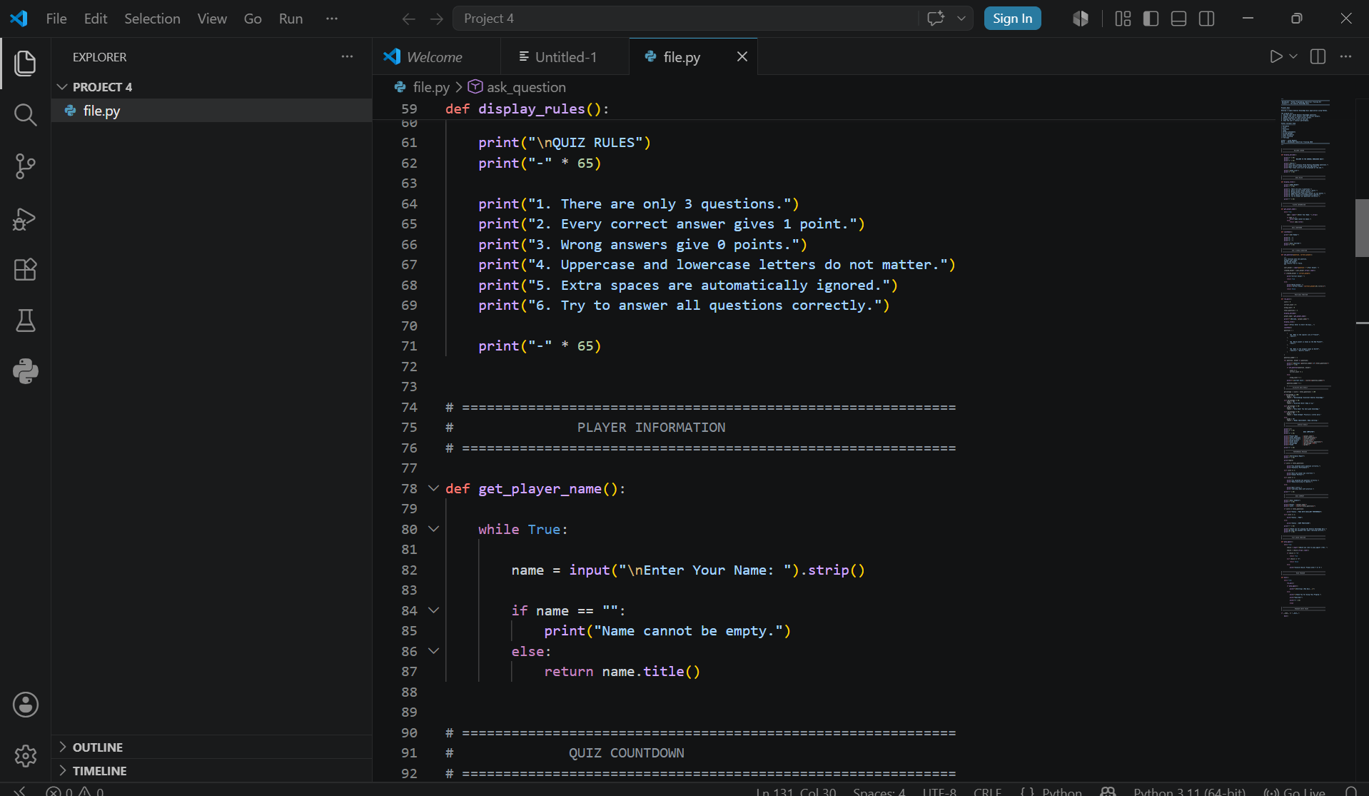

Slide 8
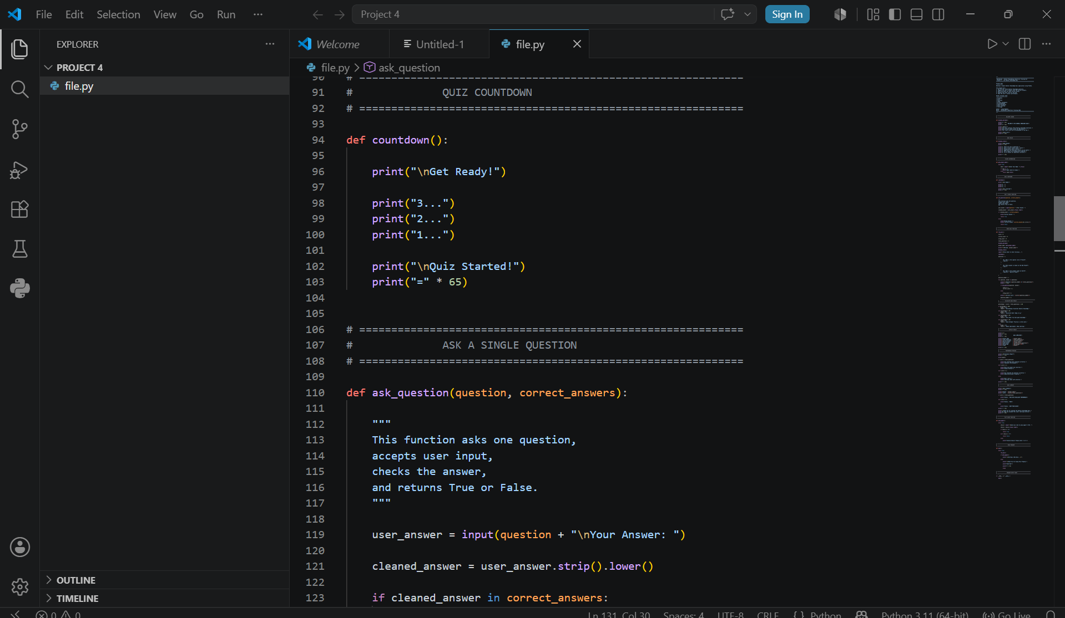

Slide 9
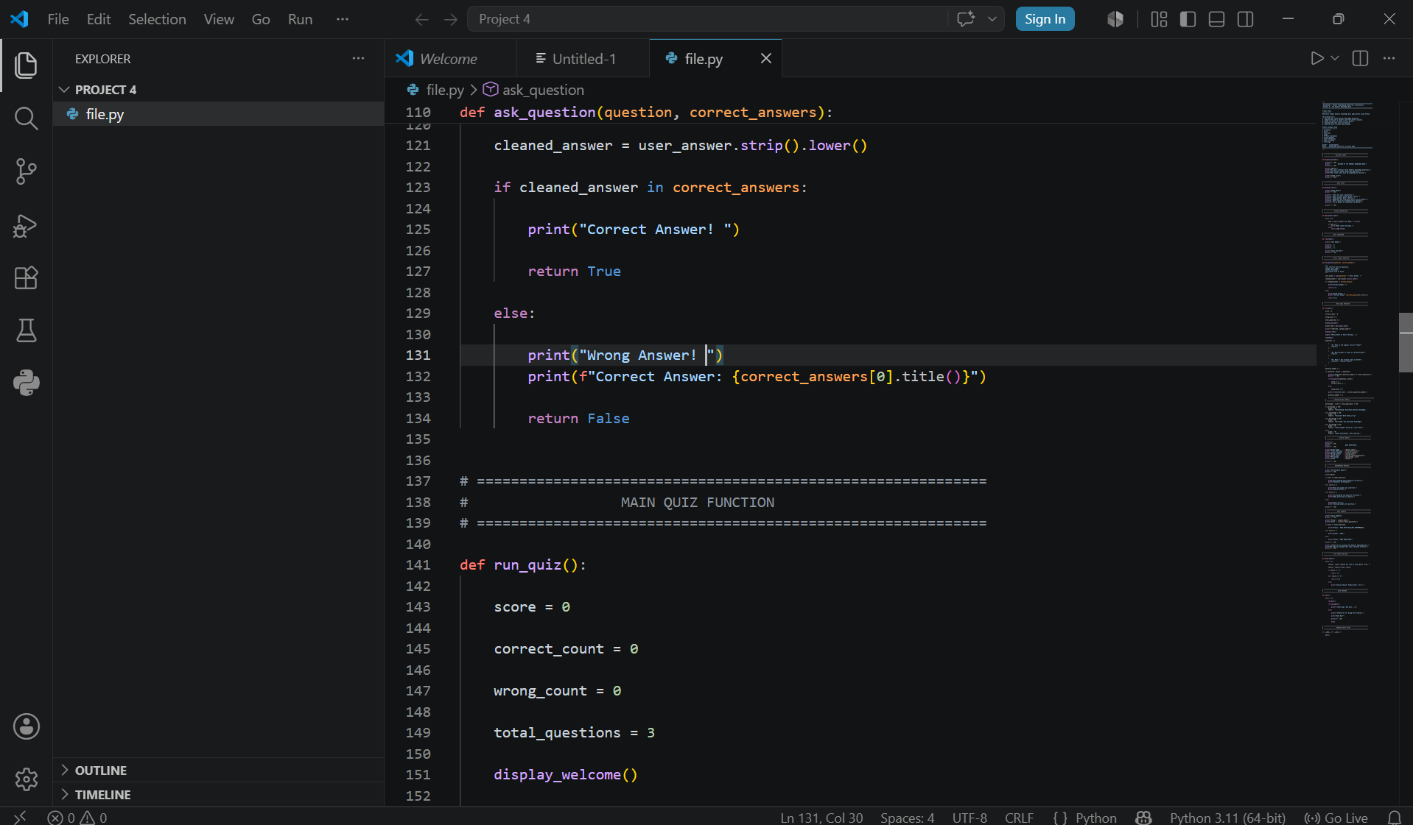

Slide 10
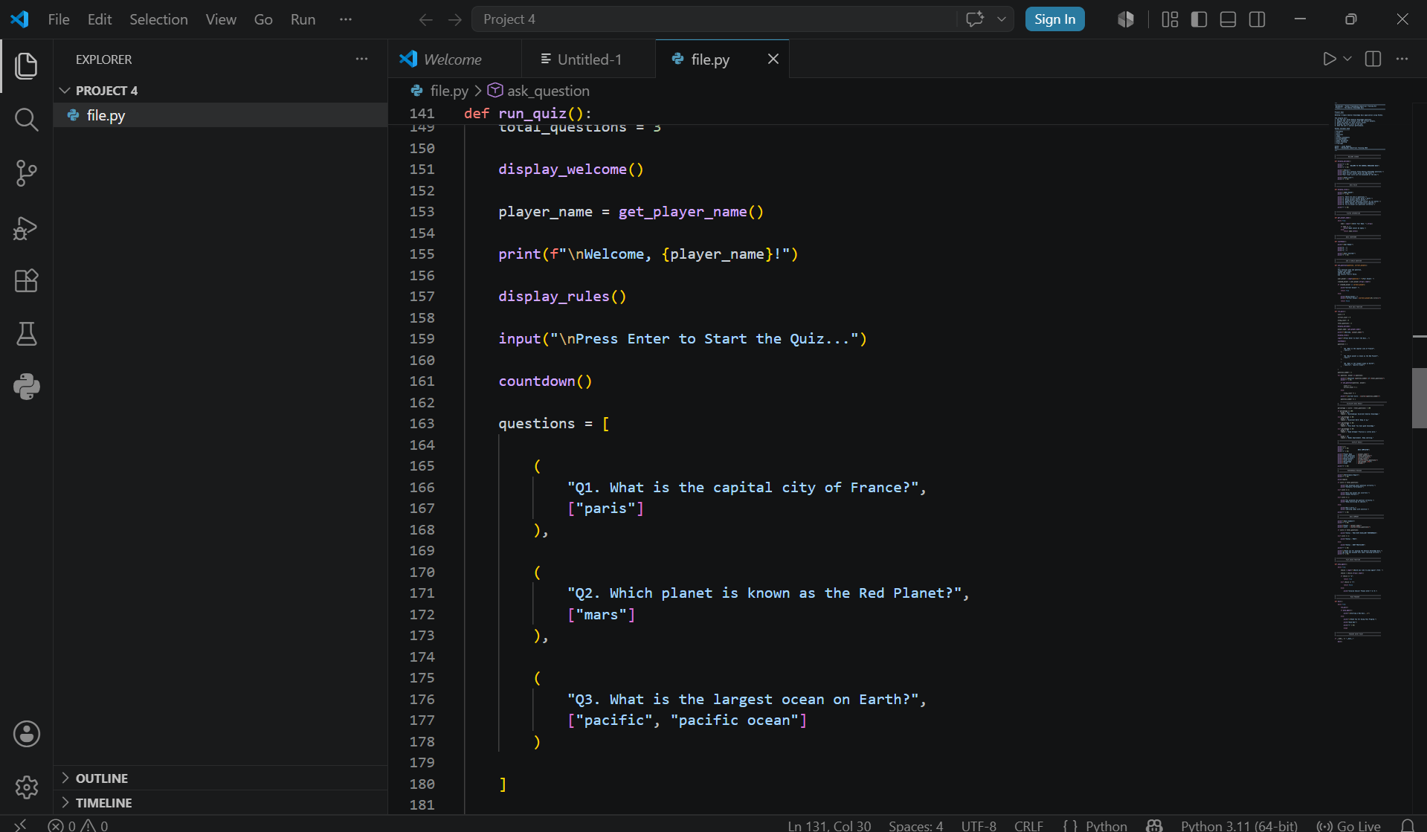

Slide 11
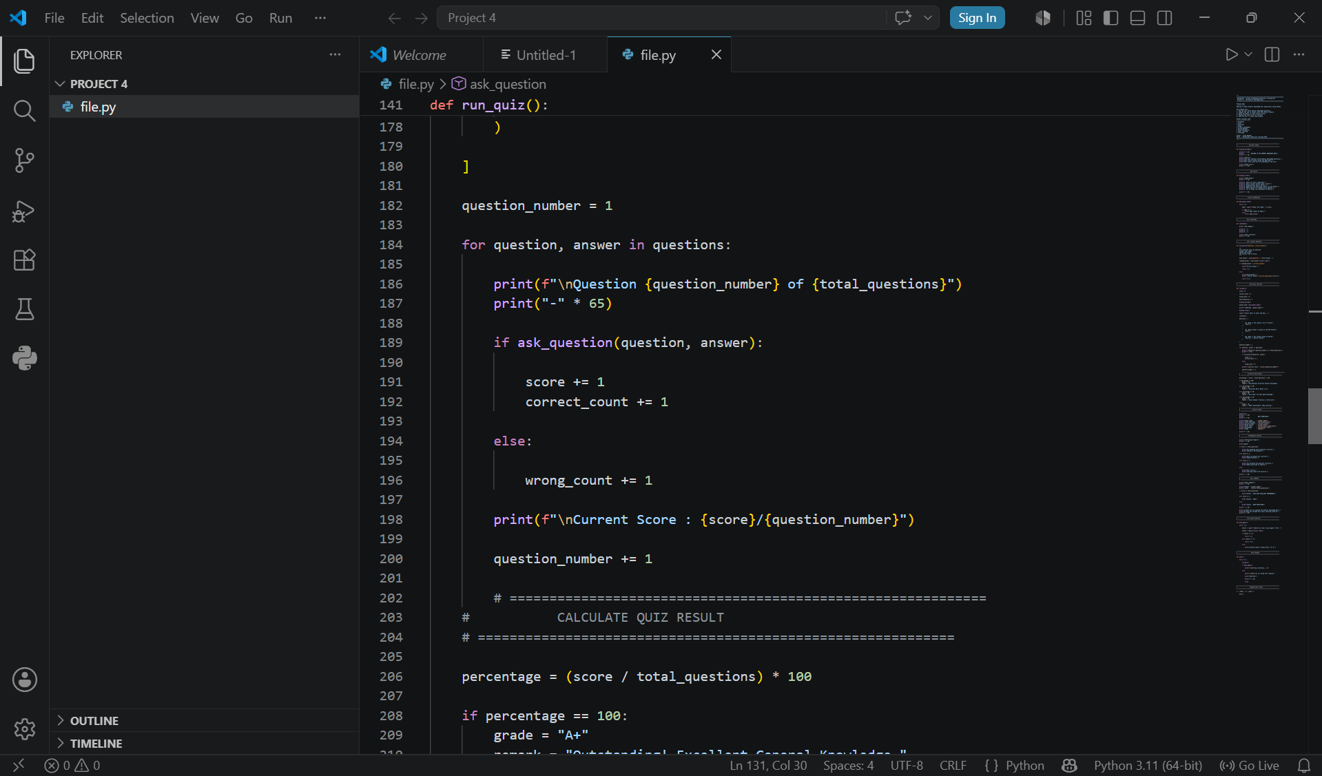

Slide 12
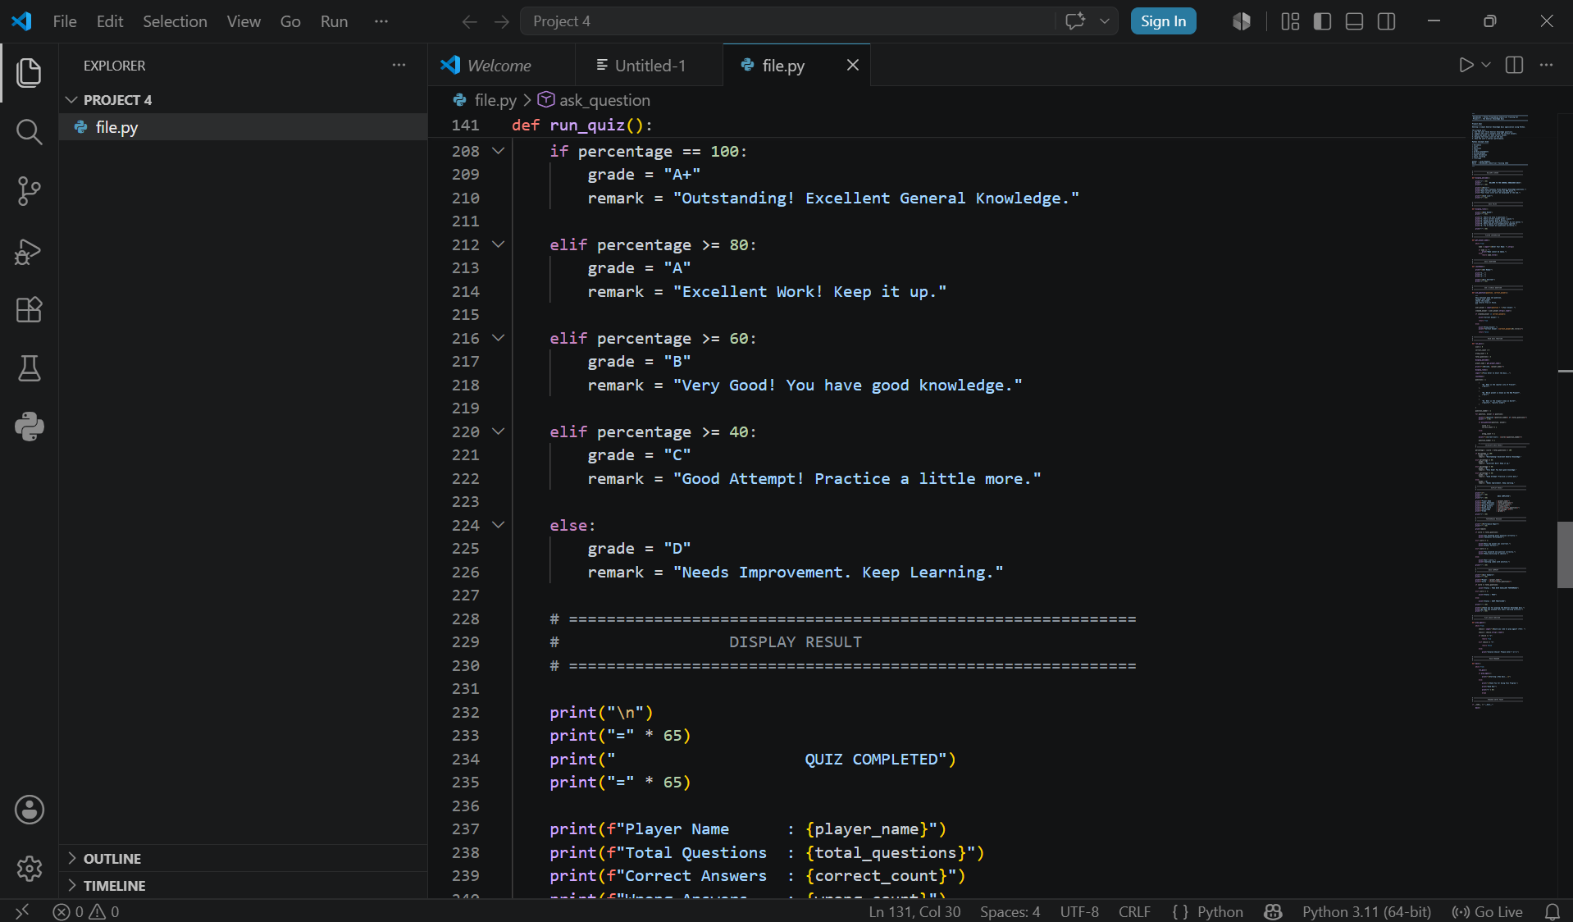

Slide 13
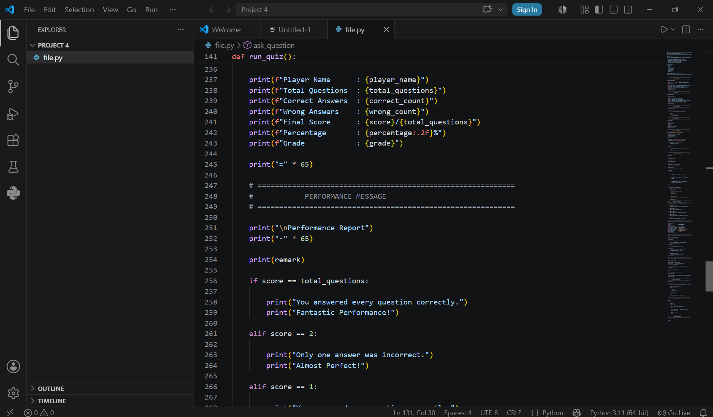

Slide 14
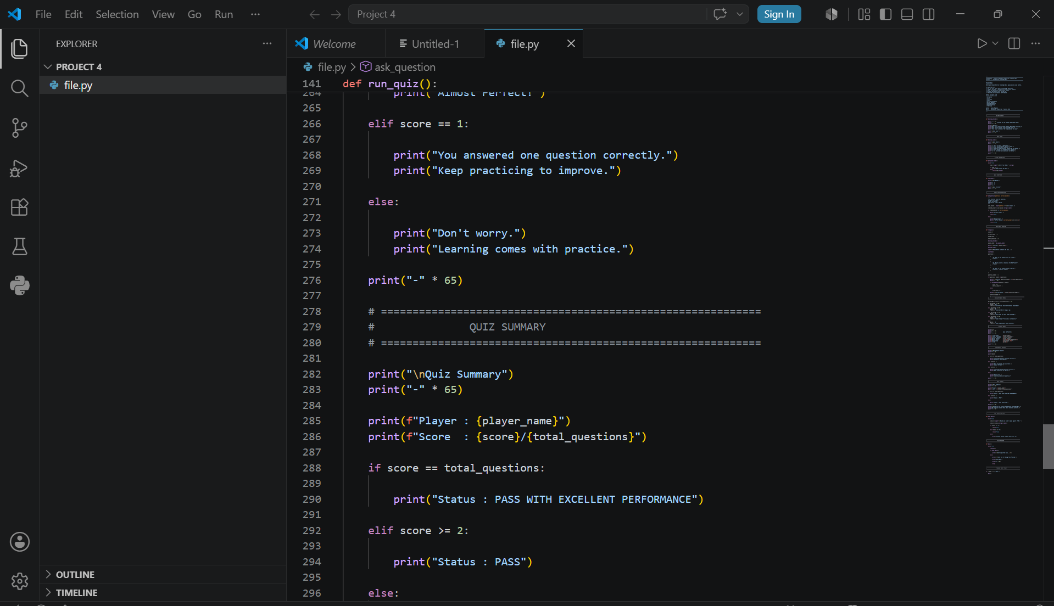

Slide 15
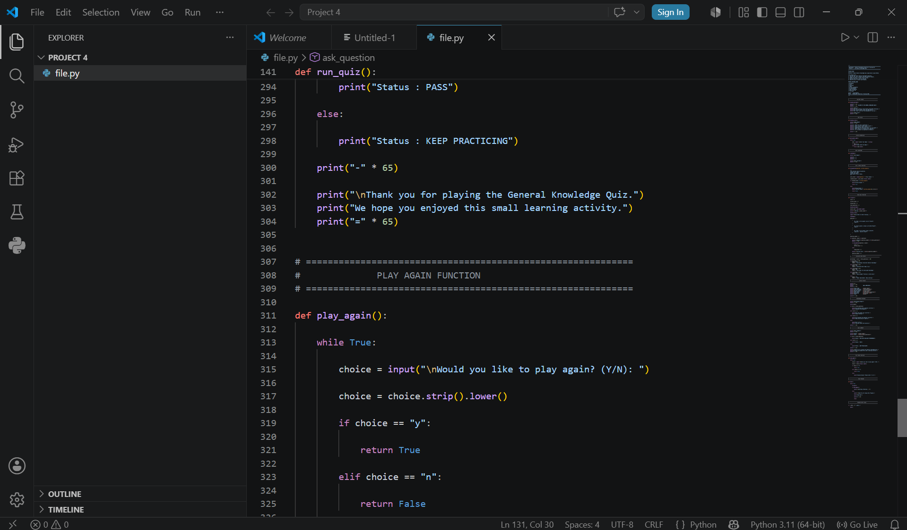

Slide 16
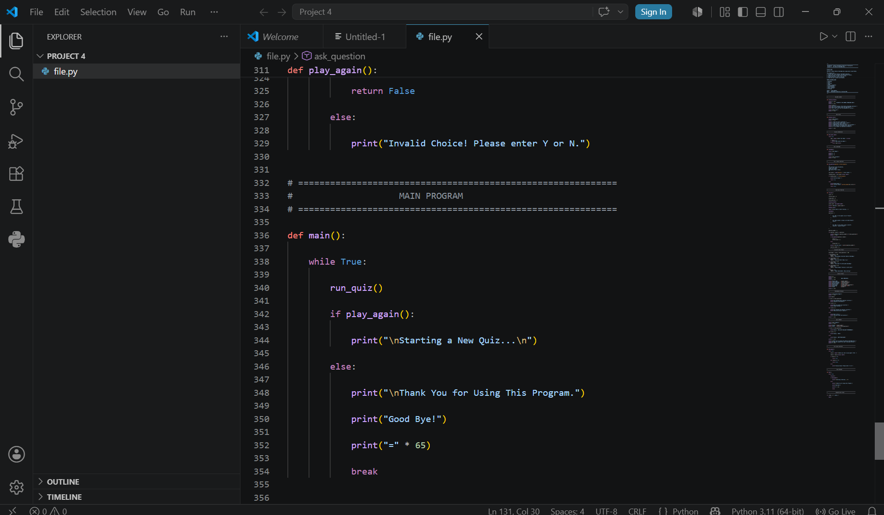

Slide 17
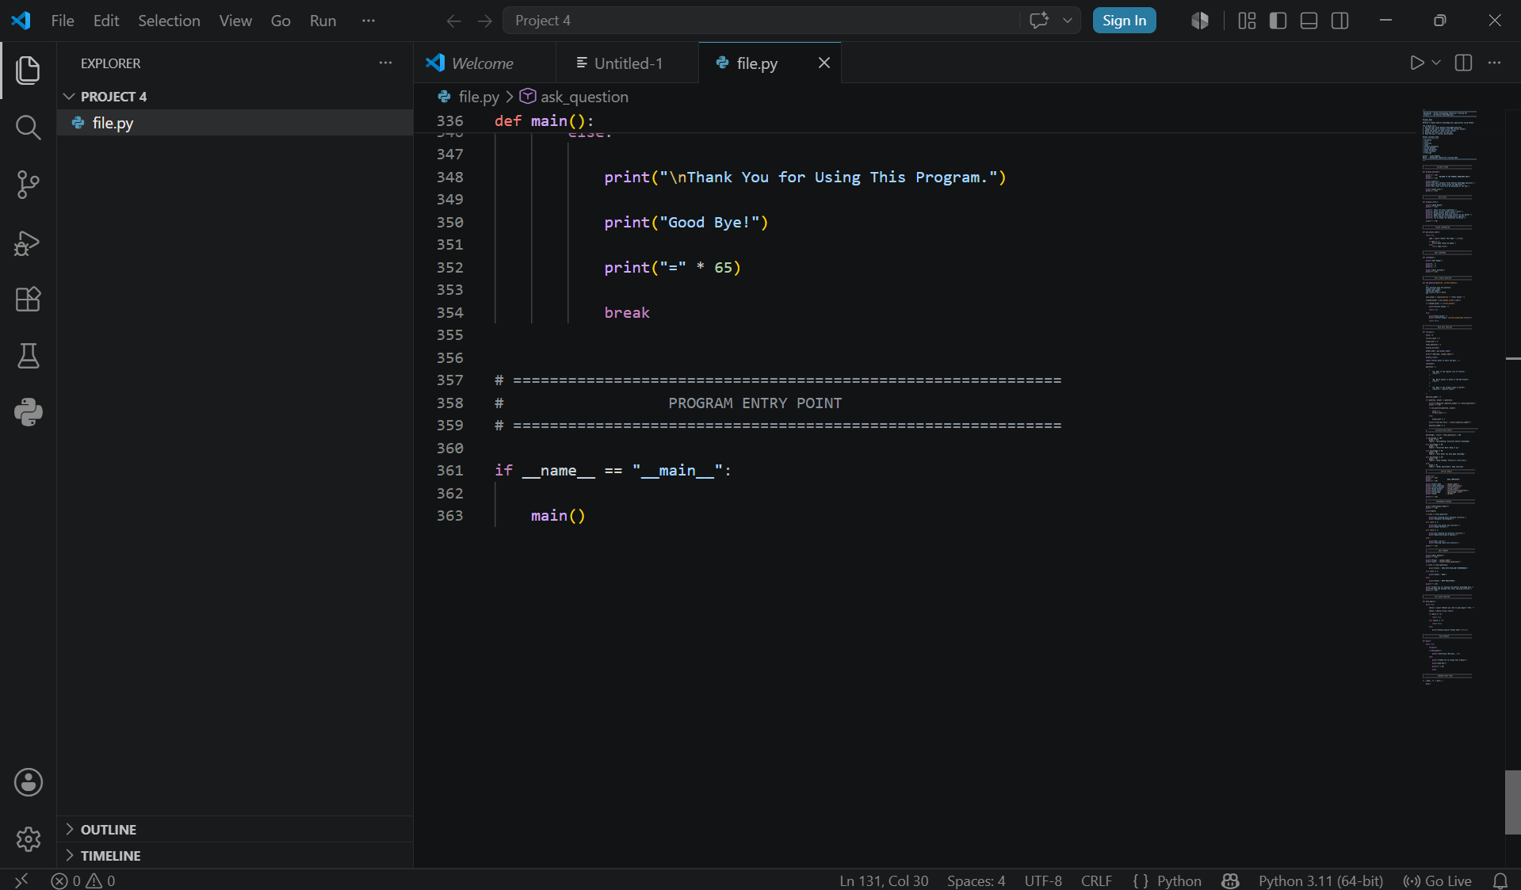

Slide 18
SCORING LOGIC
Percentage & Grade Calculation
percentage = (score / total_questions) * 100
A+
A
B
C
D
= 100%
≥ 80%
≥ 60%
≥ 40%
< 40%
Outstanding!
Excellent Work!
Very Good!
Good Attempt!
Needs Improvement
Laiba Maqbool · DecodeLabs Industrial Training 2026
5

Slide 19
Code Walkthrough
ask_question() — the core evaluation logic
def ask_question(question, correct_answers):
user_answer = input(question + "\nYour Answer: ")
cleaned_answer = user_answer.strip().lower()
if cleaned_answer in correct_answers:
print("Correct Answer! ✅")
return True
else:
print("Wrong Answer! ❌")
print(f"Correct Answer: {correct_answers[0].title()}")
return False
# Q3 example — accepts multiple valid phrasings:
("Q3. What is the largest ocean on Earth?",
["pacific", "pacific ocean"])
Laiba Maqbool · DecodeLabs Industrial Training 2026
6

Slide 20
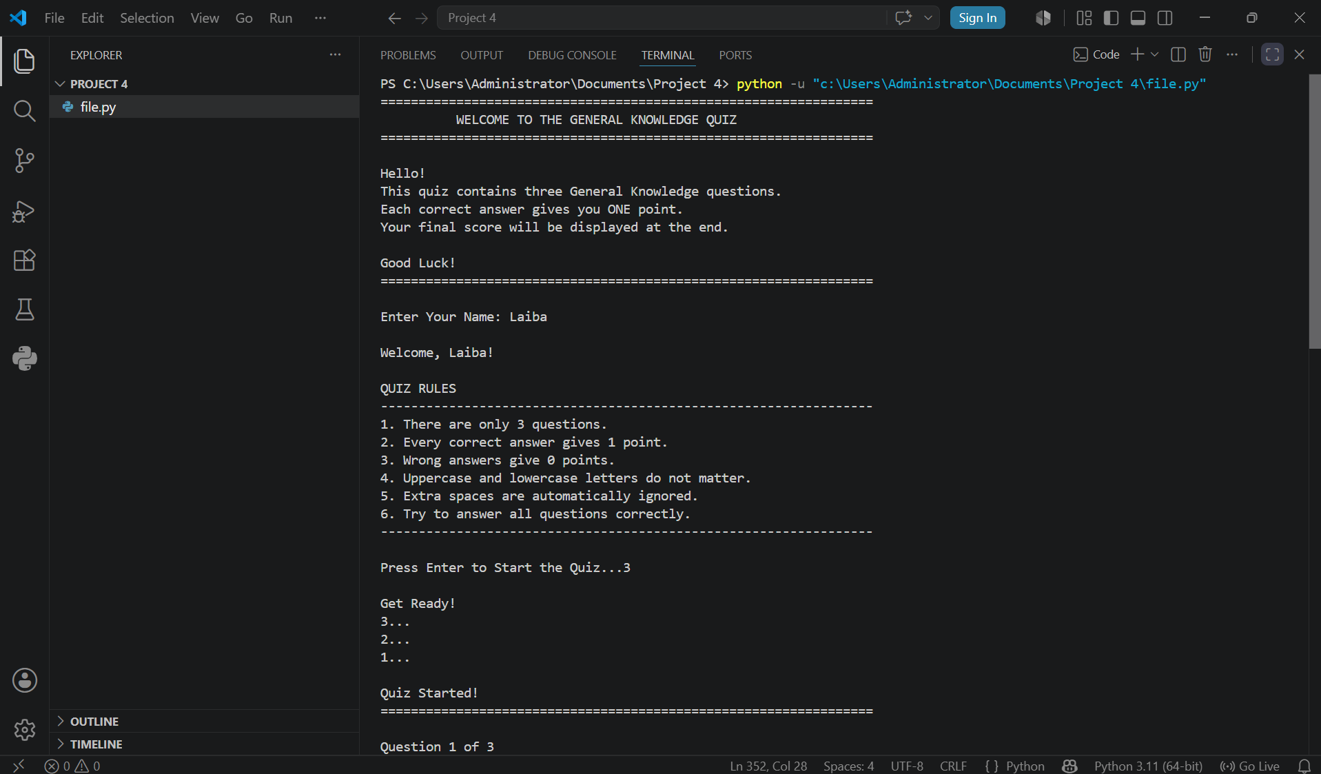

Slide 21
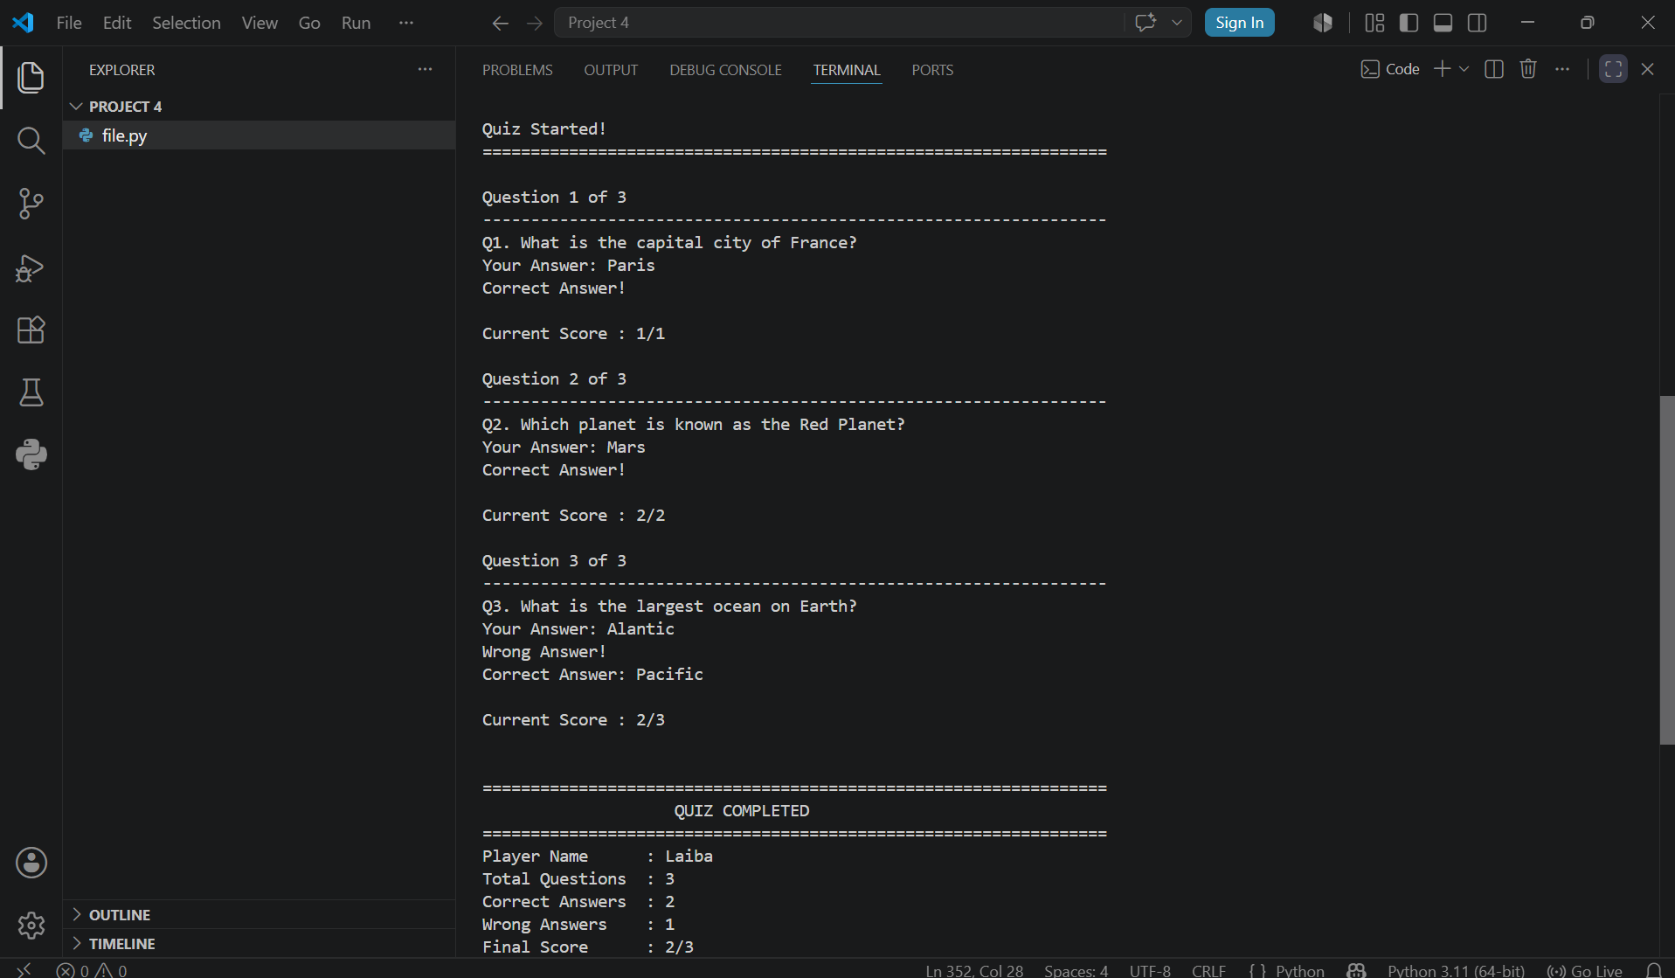

Slide 22
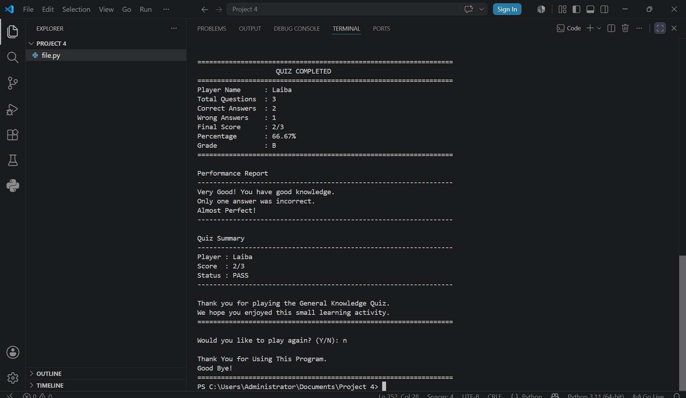

Slide 23
PROGRAM OUTPUT
Sample Run Output
A real console transcript — 2 correct, 1 wrong answer.
Question 3 of 3
Q3. What is the largest ocean on Earth?
Your Answer: Atlantic
Wrong Answer! ❌
Correct Answer: Pacific
=================================================================
QUIZ COMPLETED
=================================================================
Player Name : Laiba Maqbool
Total Questions : 3
Correct Answers : 2
Wrong Answers : 1
Final Score : 2/3
Percentage : 66.67%
Grade : B
Status : PASS
Laiba Maqbool · DecodeLabs Industrial Training 2026
7

Slide 24
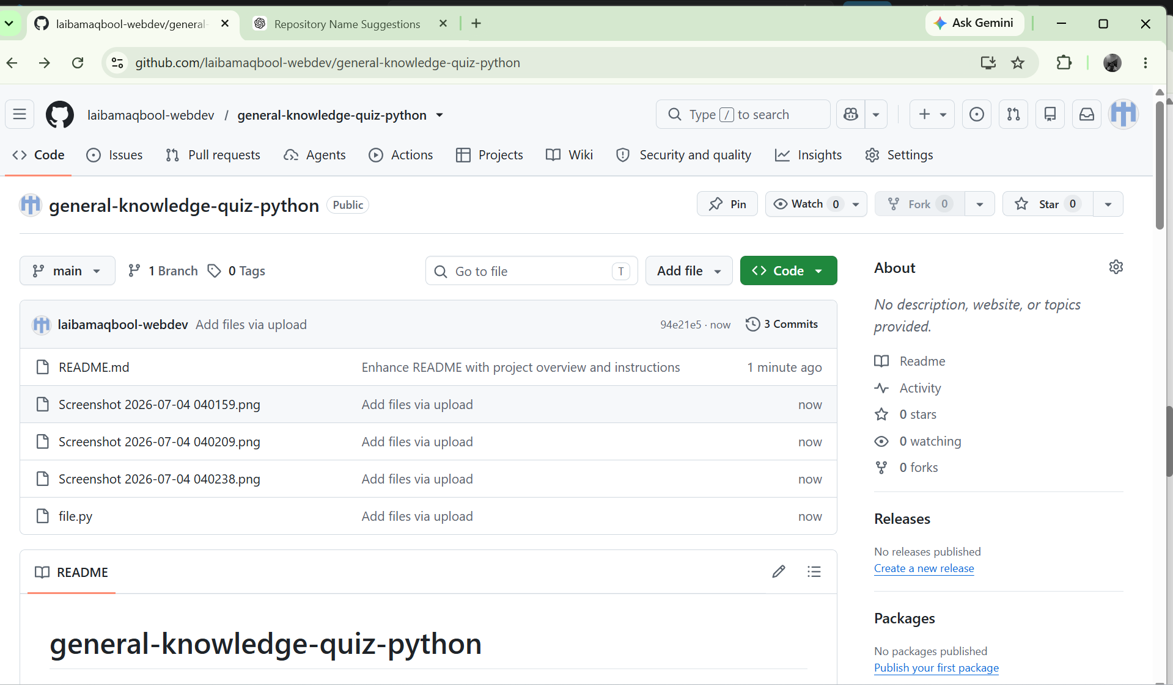

Slide 25
CONCLUSION
This program goes beyond the minimum requirement of a 3-question quiz by adding a full player experience: name capture with validation, rules and countdown screens, multiple accepted answer phrasings, a percentage-based grading system (A+ to D), a personalized performance report, and a replay loop. Together these demonstrate strong command of variables, functions, loops, conditionals, and clean f-string output.
Laiba Maqbool | DecodeLabs Industrial Training 2026

